Slide 1

FINAL REVIEW DDoS Protection System for Cloud: Architecture and Tool Project Category : RESEARCH
Supervisor Name Dr. Balaji Srikaanth P, AP/NWC Dr. S. Nagendra Prabhu, AP/CINTEL | Batch No. NW000156 Shaurya Singh Srinet – RA2111032010006 Shounak Chandra – RA2111032010026 Charvi Jain – RA2111047010113

Slide 2
Abstract
Increasing cloud adoption heightens the risk of DDoS attacks, threatening service availability and data security.
We propose a scalable DDoS Protection System designed for real-time detection and mitigation in cloud environments.
Utilizes a multi-layered architecture with machine learning to distinguish between malicious and legitimate traffic patterns.
Ensures seamless integration across various cloud platforms while maintaining performance and minimizing false positives.
Aligns with industry security standards to safeguard data integrity and service continuity.

Slide 3
Introduction
Proposed Solution:
Cloud-native DDoS Protection System using machine learning for real-time anomaly detection and automated traffic filtering.
Differentiates between malicious and legitimate traffic to ensure continuous service.
Key Features:
Scalable and adaptable to various cloud architectures.
Compliant with industry standards for data integrity and security.
Impact:
Handles high traffic volumes (many Mbps) while maintaining optimal cloud resource utilization.
Ensures uninterrupted user experience with no service degradation or increased latency.
Adapts over time, improving detection and response by learning emerging attack patterns.

Slide 4
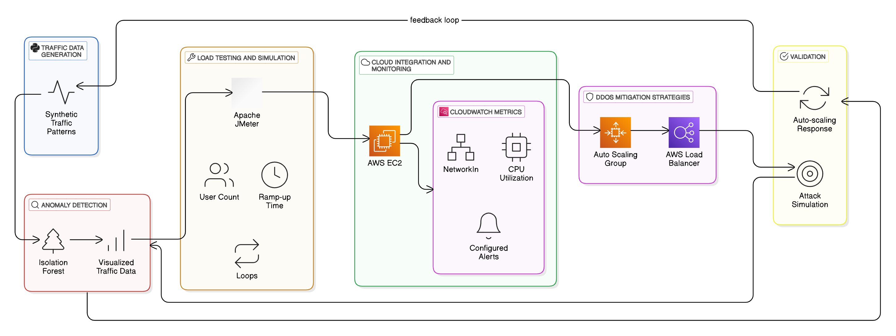
Architecture Diagram

Slide 5
Dynamic Traffic Mitigation Implementation
Real-Time Filtering:
Traffic is filtered dynamically in response to detected DDoS attacks.
Ensures minimal impact on service availability during attacks.
AWS Integration:
Auto-Scaling: Scales resources automatically during attack scenarios.
Load Balancing: Distributes traffic to ensure even resource utilization.
CloudWatch Monitoring: Provides real-time metrics for tracking system performance during attacks.

Slide 6
Continuous Model Enhancement and Testing
Model Optimization:
Experimented with hyperparameter tuning and feature selection to improve model accuracy.
Machine Learning Integration:
The Isolation Forest model is now fully integrated into the AWS cloud environment for real-time attack detection.
Ongoing Testing:
The model has been tested on various attack types (volumetric, application-layer), with positive results in terms of detection and mitigation.

Slide 7
Real-Time Attack Detection and Mitigation
Real-Time Cloud Monitoring:
Isolation Forest model continuously monitors traffic data from cloud-hosted websites.
Attack Scenarios Tested:
Simulated volumetric and application-layer DDoS attacks.
The system successfully triggered Auto-Scaling and Load Balancing strategies to mitigate attack effects.
Key Results:
The system scaled cloud resources effectively without performance degradation.
Ensured continuous service availability during attacks.

